Slide 1
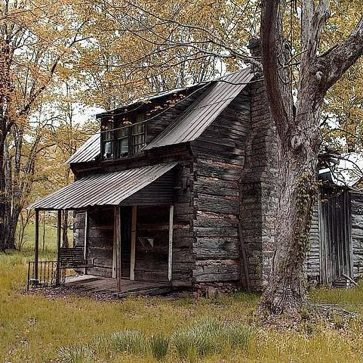
The Thirteen Colonies
Part 5
Life in the Backcountry

Slide 2
Questions to Answer
What is the backcountry like?
Who settled in the backcountry?
What was life like for those colonists who settled in the backcountry?

Slide 3
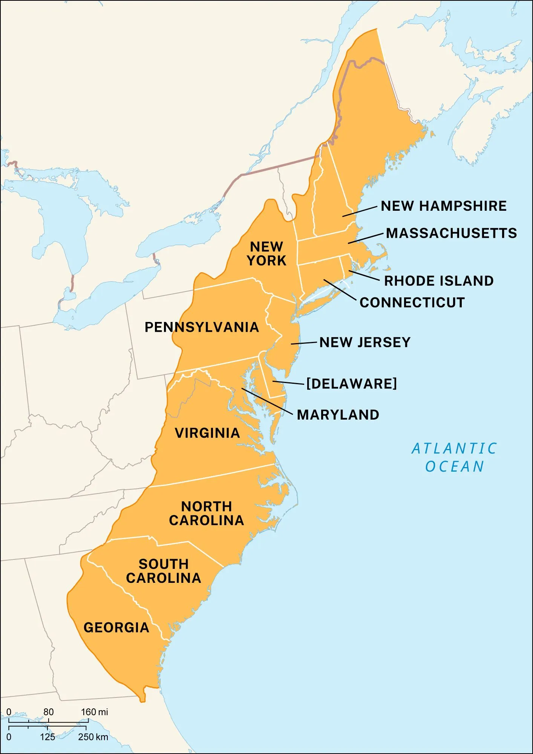
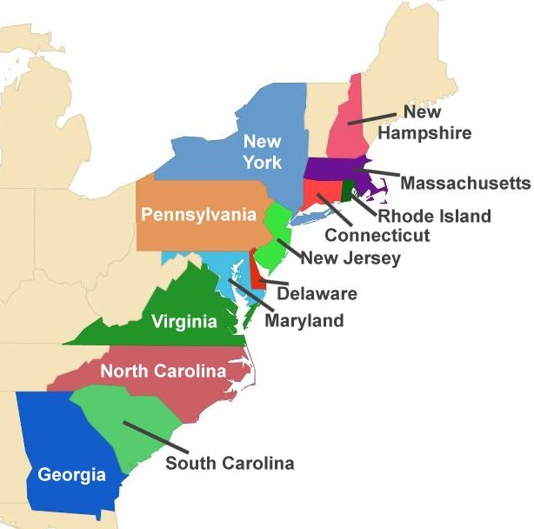

Slide 4
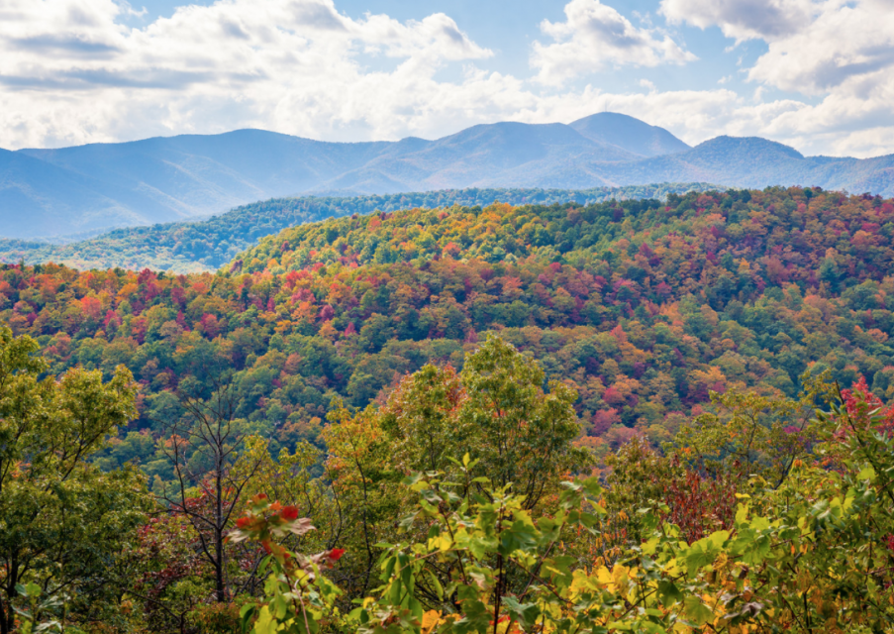
A remote, isolated area in the wilderness that was difficult to access along the Appalachian mountains was known as the backcountry or frontier.

Slide 5
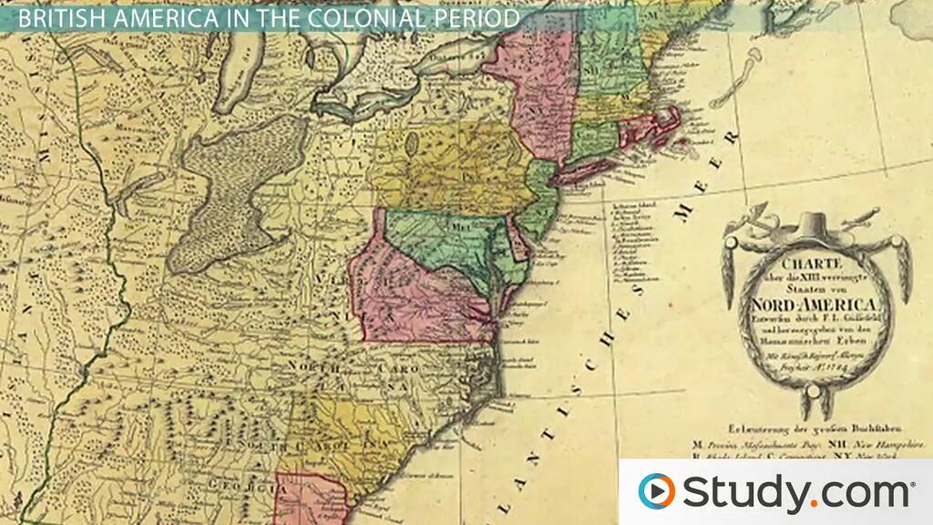
The backcountry laid along the western edge of the colonies.

Slide 6
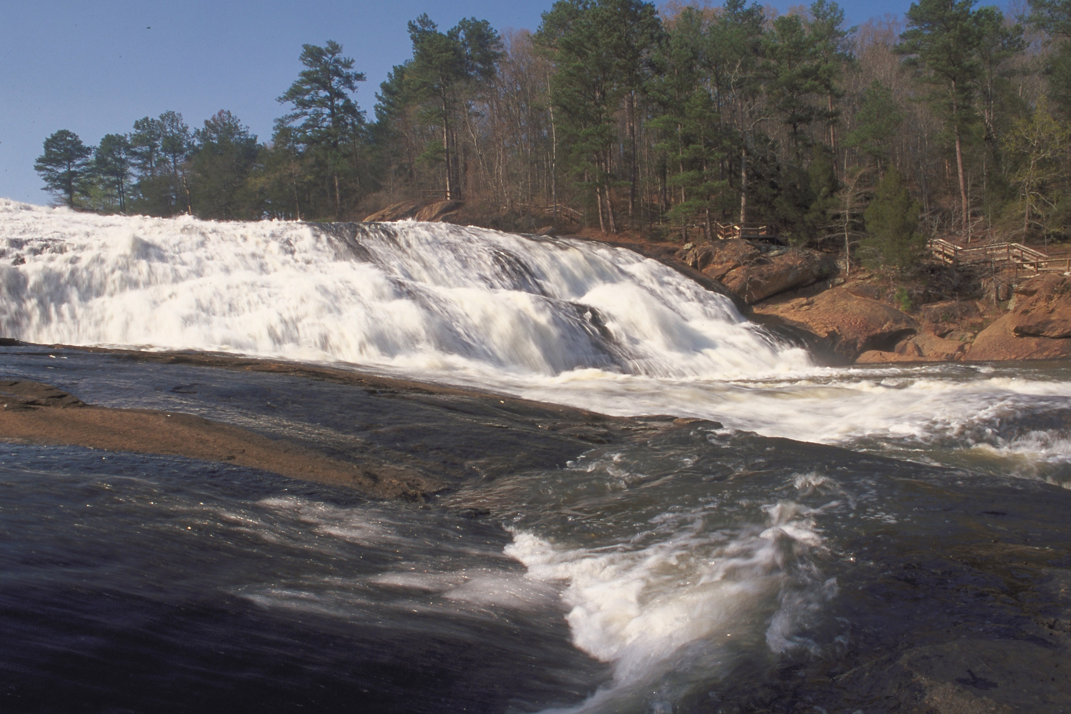
In the South, the backcountry first started at the fall line- the point at which waterfalls made river navigation impossible for large boats.

Slide 7
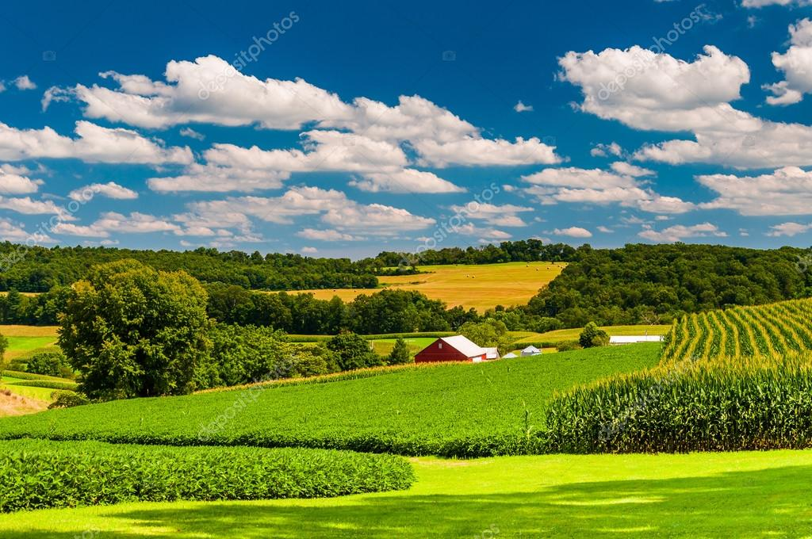
In the Mid-Atlantic region, the backcountry started on the western side of the piedmont. The piedmont is a wide plateau made up of rolling hills that has very rich soil good for farming.

Slide 8
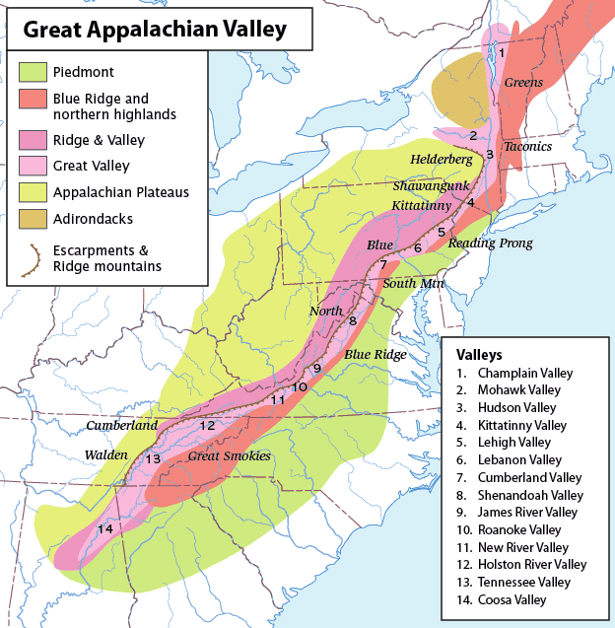

Slide 9
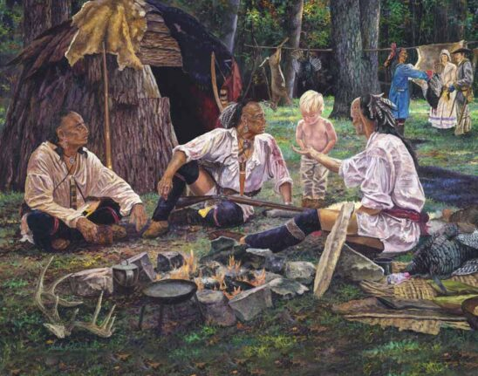
The first Europeans in the backcountry were Indian traders. Deer skins were common currency on the frontier.

Slide 10
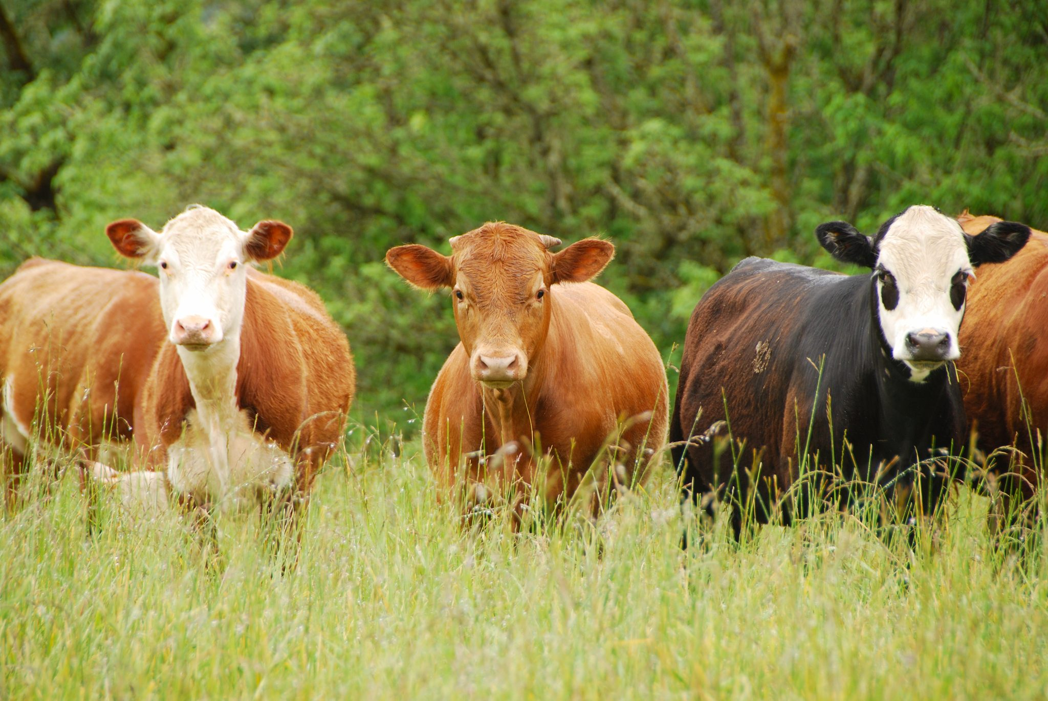
As time went on, cattle ranchers and then settlers moved into the area.

Slide 11
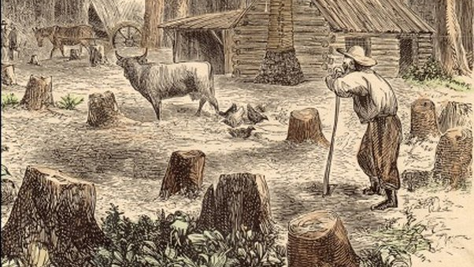
People moved to the backcountry for different reasons.

Slide 12
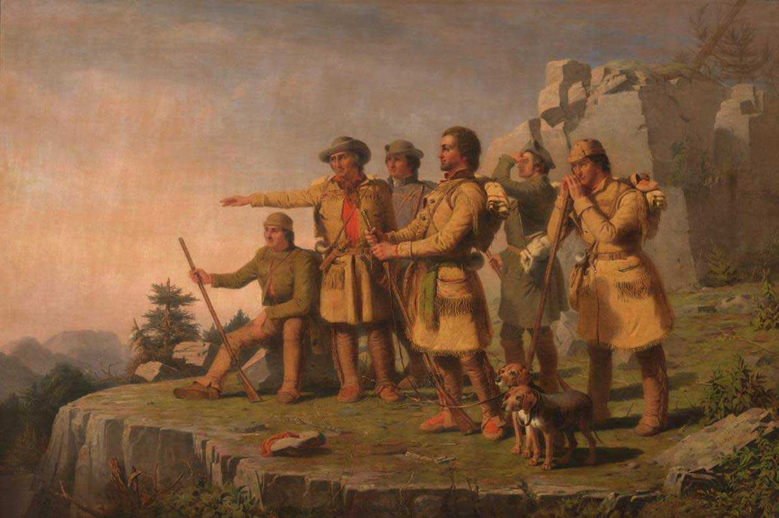
Some in the South moved to the frontier to get away from plantation agriculture. Others were looking for a place to live far away from and other settlers.

Slide 13
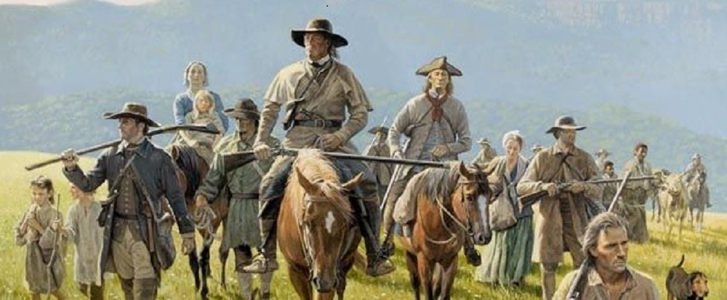
Many Germans and Scots-Irish moved into the backcountry for an opportunity to start a new life.

Slide 14
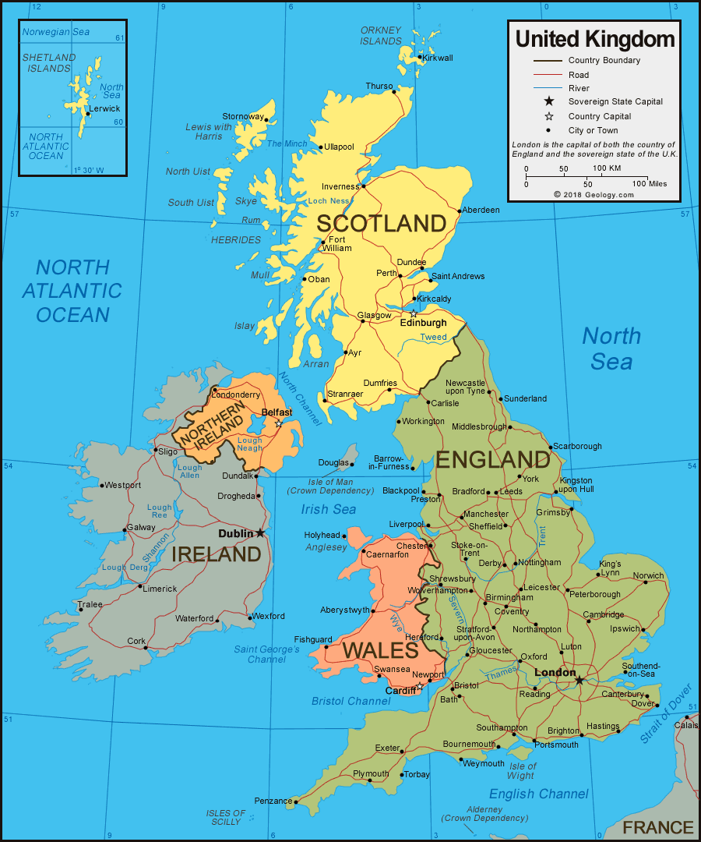
Scots-Irish were people who came from the borderland between Scotland and England, who were often at war with each other.

Slide 15
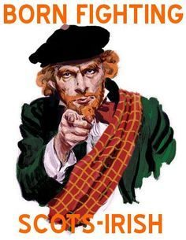
These Scot-Irish “relied on family rather than government, distrusted outsiders, and were always ready to fight. They valued liberty, religion, and responsibility.” –pg. 149 America’s Past and Promise

Slide 16
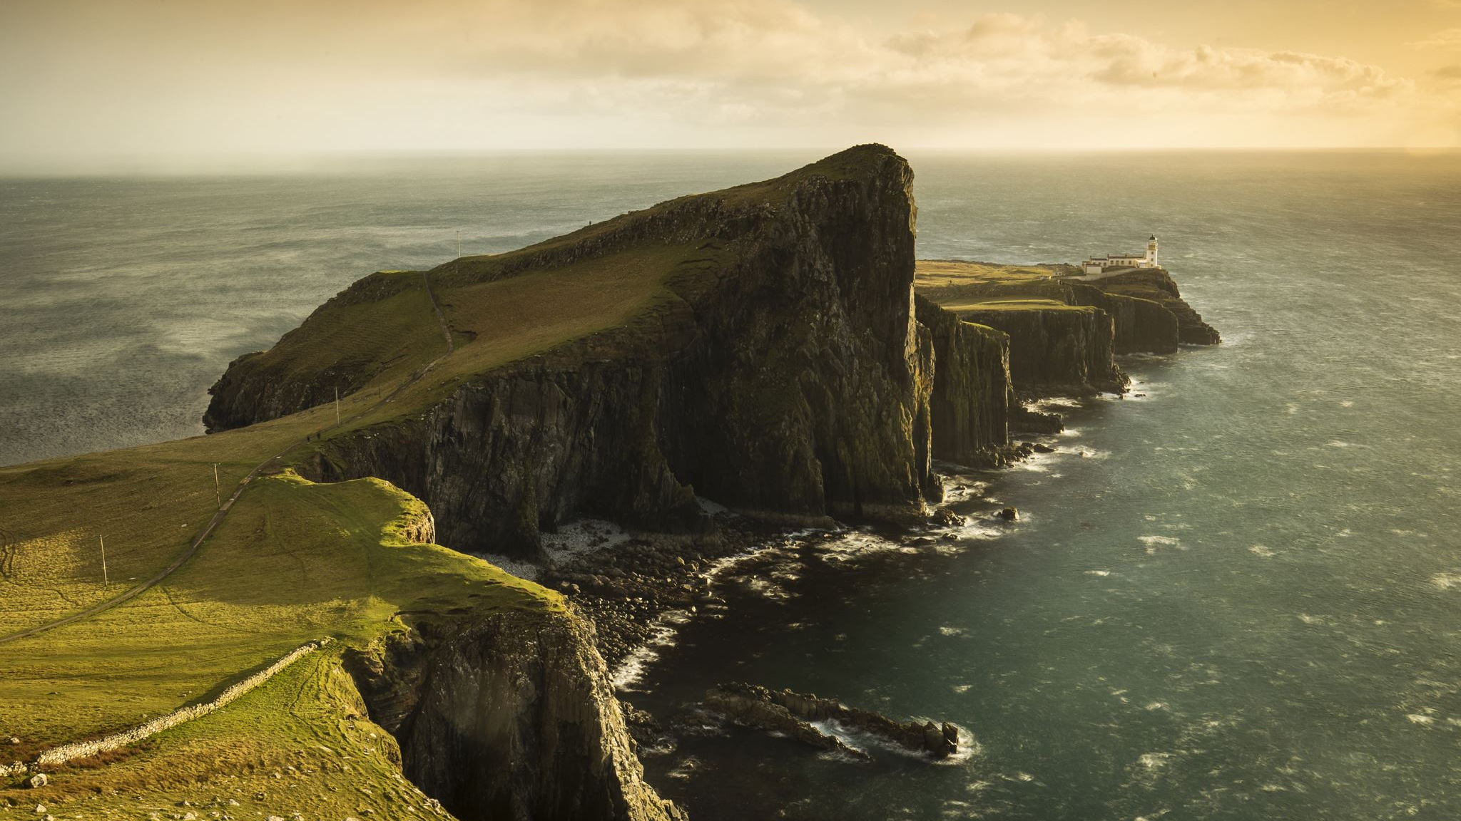
Many of them moved to northern Ireland (that’s where the Irish comes from in the name Scots-Irish) for a new life, but soon found themselves in America; eventually moving to the frontier.

Slide 17
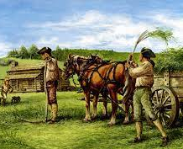
Family was the most important social unit in the backcountry. People had to rely on each other when danger presented itself.

Slide 18
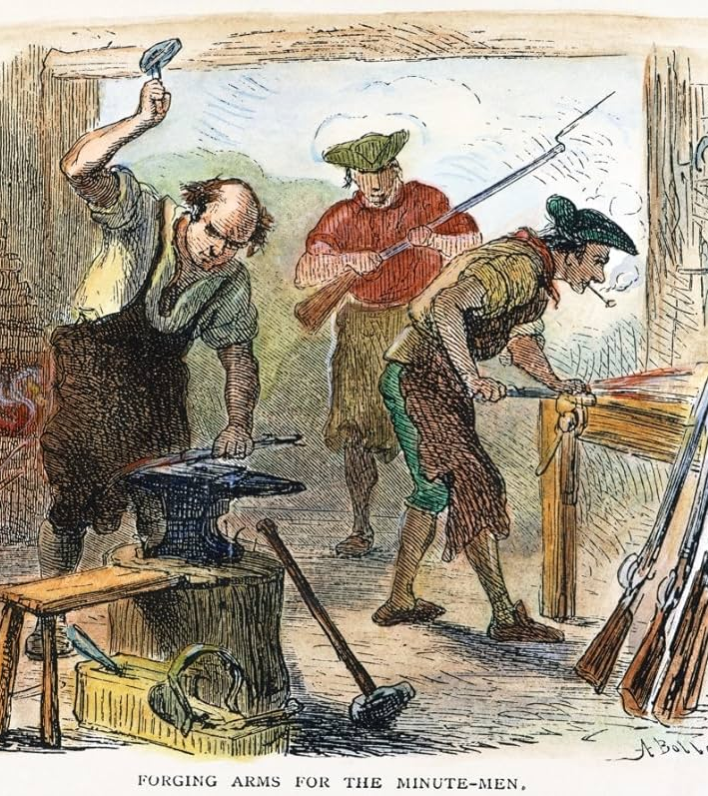
Life in the backcountry was challenging. Being so far away from civilization, families had to produce for themselves everything they needed for survival.

Slide 19
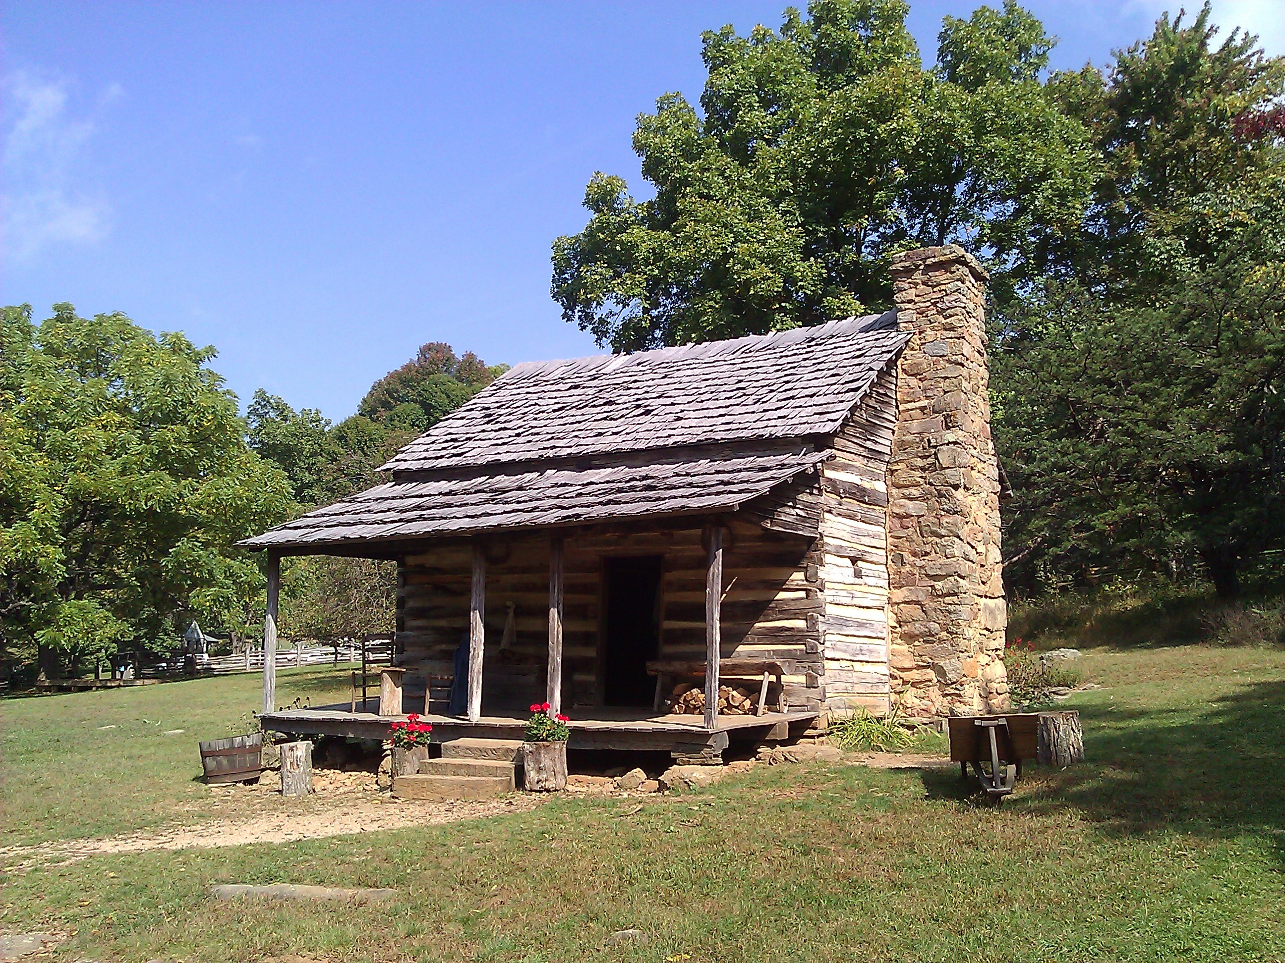
Log cabins were built because there was plenty of available timber, and one only needed an axe to build one.

Slide 20
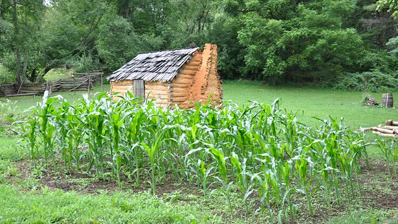
Families cleared land for small farms, raised animals, and hunted for food.

Slide 21
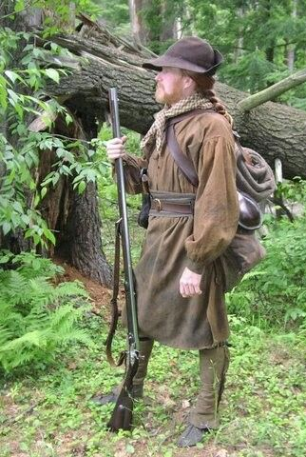
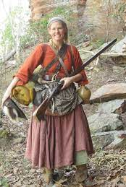
Clothing was homemade from deerskins or homespun cloth. Often people went without shoes in warmer weather.

Slide 22
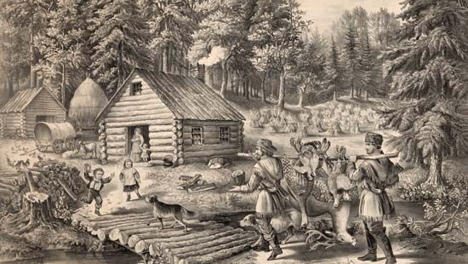
Children didn’t go to school and were often taught at home without books.

Slide 23
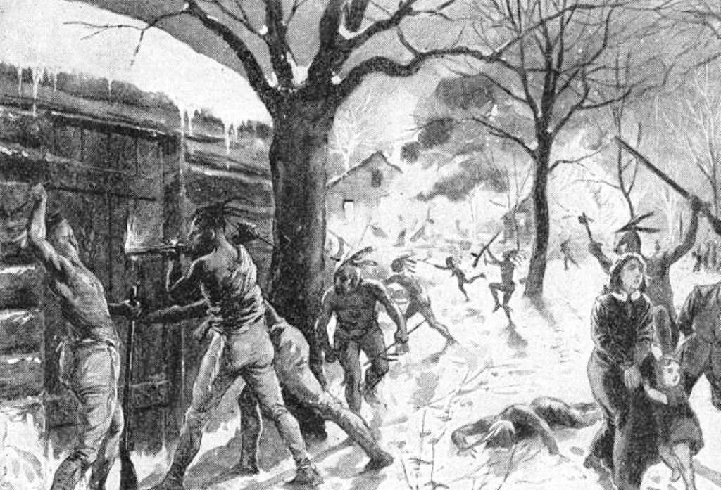
Relations with Native Americans were mixed. At times, the settlers were friendly with the Native Americans, and they traded with each other. Other times there was conflict which resulted in violence.

Slide 24
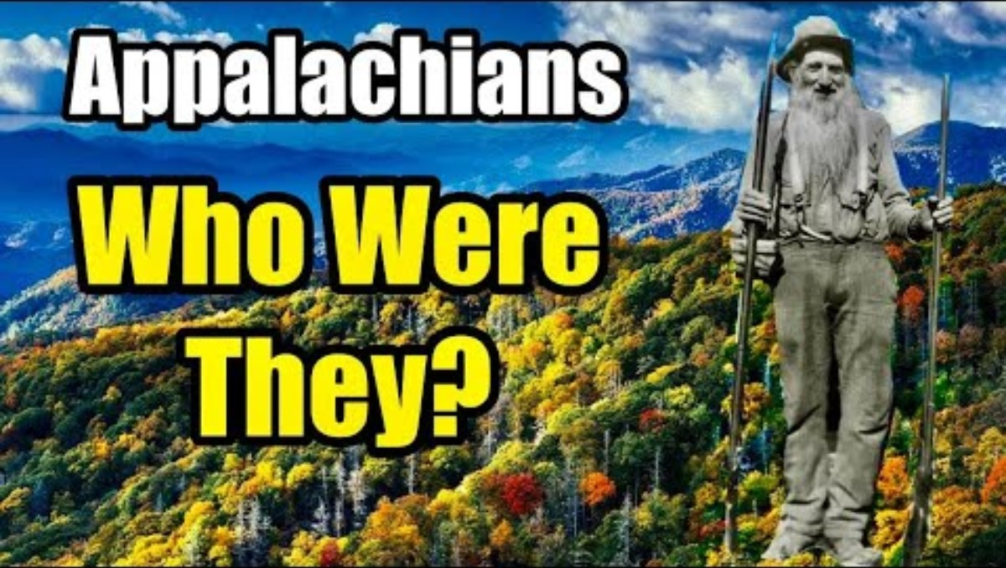
Video

